Slide 1
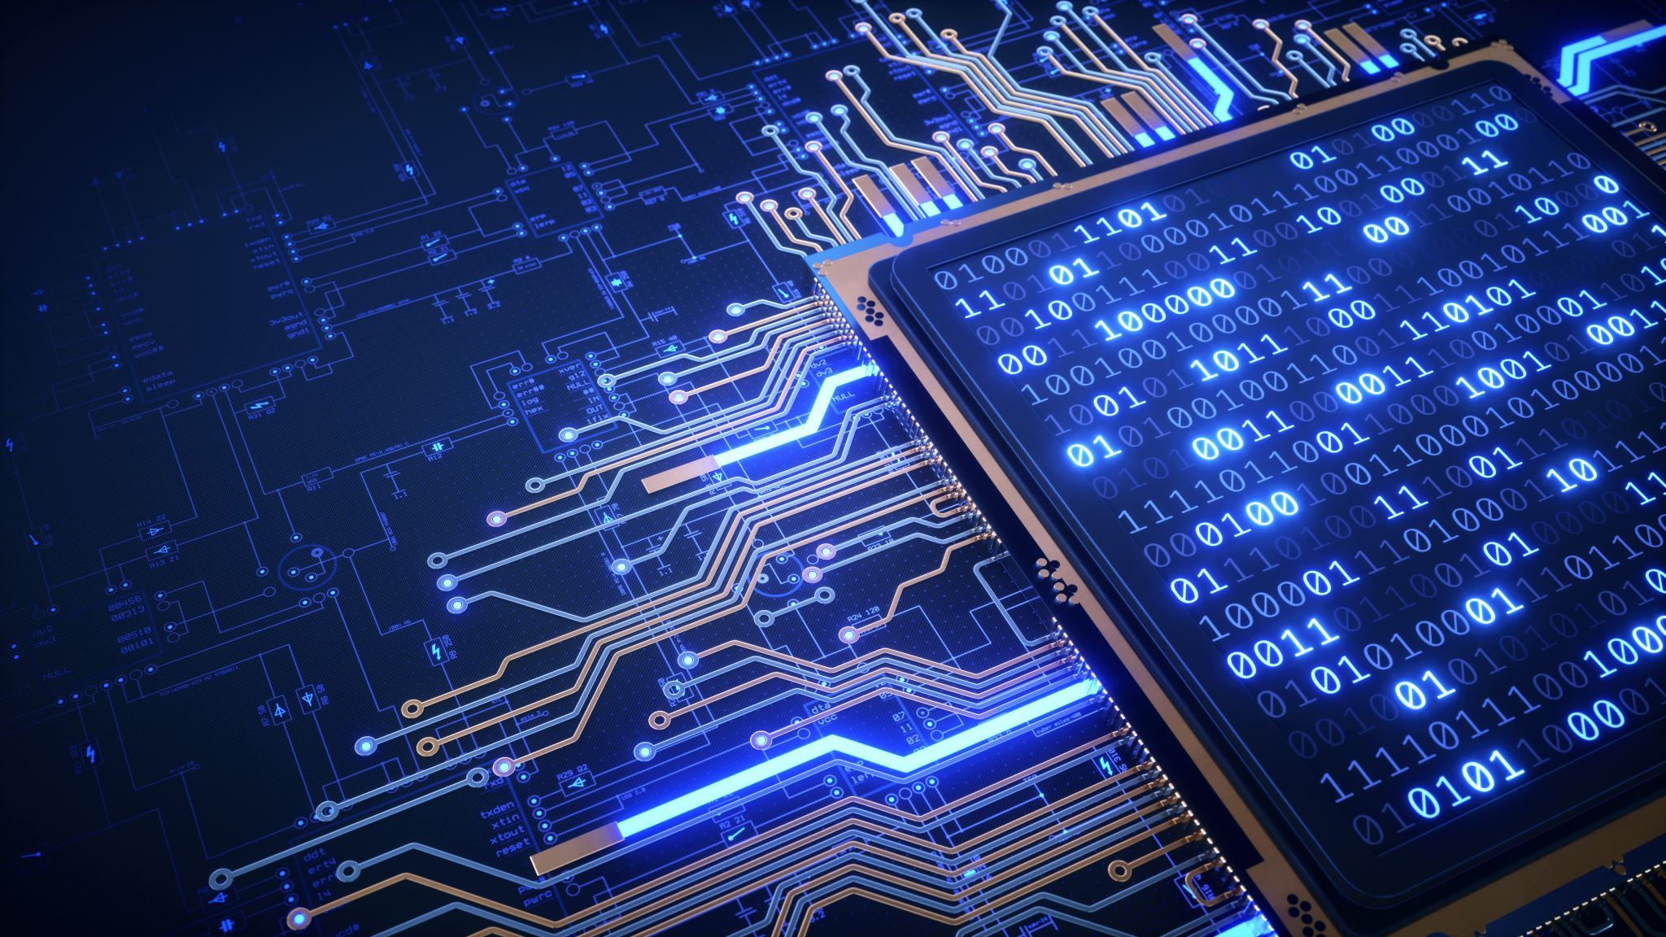
HOME AUTOMATION INTERNET OF THINGS MUHAMMAD HASSAN KAHLID MUHAMMAD HAMZA

Slide 2
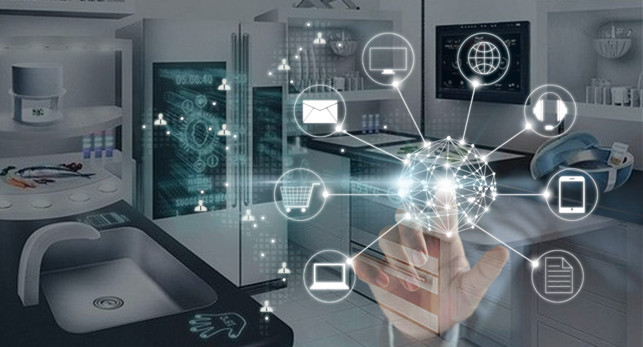
FROM elnofochips

Slide 3
WHAT IS HOME AUTOMATION?
Home automation is a network of hardware, communication, and electronic interfaces that work to integrate everyday devices with one another via the Internet. Each device has sensors and is connected through WiFi, so you can manage them from your smartphone or tablet whether you’re at home, or miles away. This allows you to turn on the lights, lock the front door, or even turn down the heat, no matter where you are.
FROM XFINITY Discovery Hub

Slide 4
There are three main elements of a home automation system: sensors, controllers, and actuators.
Sensors can monitor changes in daylight, temperature, or motion detection. Home automation systems can then adjust those settings (and more) to your preferences.
Controllers refer to the devices — personal computers, tablets or smartphones — used to send and receive messages about the status of automated features in your home.
Actuators may be light switches, motors, or motorized valves that control the actual mechanism, or function, of a home automation system. They are programmed to be activated by a remote command from a controller.
FROM XFINITY Discovery Hub

Slide 5
Home automation systems offer a variety of services and functions. Some of the more common features available through these platforms include:
Fire and carbon monoxide monitoring
Remote lighting control
Thermostat control
Appliance control
Home automation security systems and cameras
Live video surveillance
Alarm systems
Real-time text and email alerts
Digital personal assistant integration
Keyless entry
Voice-activated control
FROM XFINITY Discovery Hub

Slide 6
What are the benefits of home automation?
Remote access: Control your home from mobile devices, including your laptop, tablet, or smartphone.
Comfort: Use home automation to make your home a more comfortable, livable space. Preprogram your thermostat with your preferred settings so that your home is always at a comfortable temperature, set up smart speakers to play music when you get home from work, or adjust your lights to soften or brighten based on the time of day.
Convenience: Program devices to turn on automatically at certain times, or access their settings remotely from anywhere with an Internet connection.
Increased safety: Smart fire detectors, carbon monoxide monitors, pressure sensors.
Energy efficiency: Home automation allows you to be more mindful of your power usage.
FROM XFINITY Discovery Hub

Slide 7
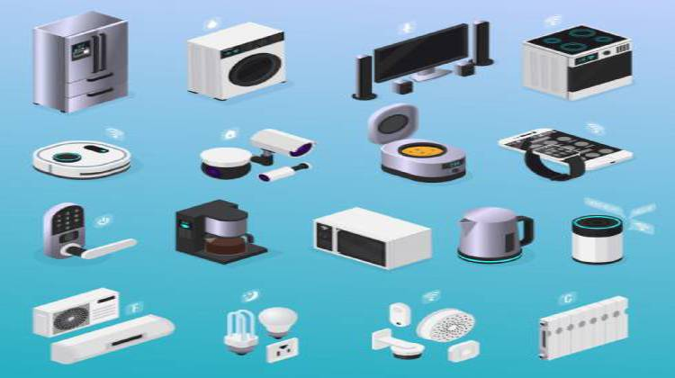
FROM HOME AUTOMATION

Slide 8
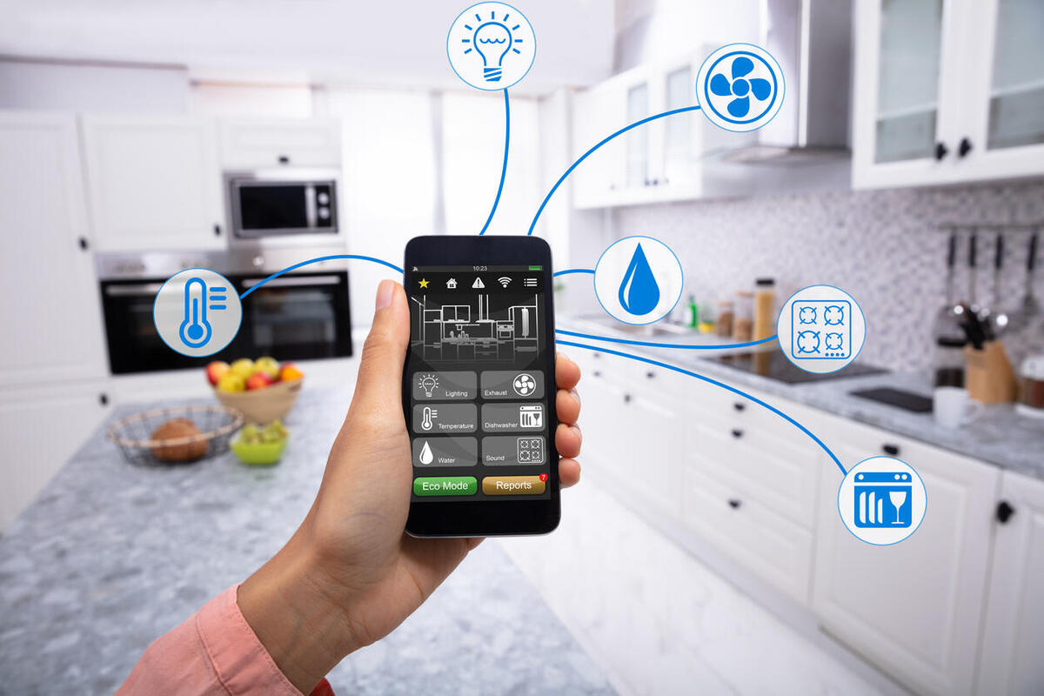
FROM TECH REPUBLIC

Slide 9
Voice assistants are programs on digital devices that listen and respond to verbal commands. A user can say, “What's the weather?” and the voice assistant will answer with the weather report for that day and location. They could say, “Tell me a story,” and the assistant will jump into a tale. These Voice assistants can be used to control your home automated devices.
FROM TECNO SPOT

Slide 10
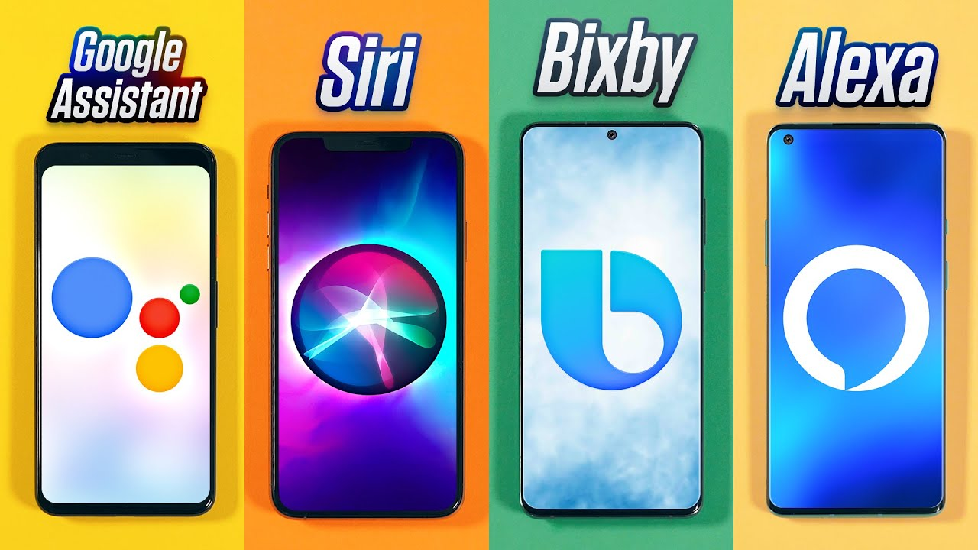
FROM Mrwhoosetheboss

Slide 11
Common home automation issues
1. Sub systems not integrating
2. Insufficient features and functionality
3. Too many home automation control apps
4. Lengthy delays during the construction of your project
5. Sub system suppliers lacking smart knowledge
FROM ITA

Slide 12
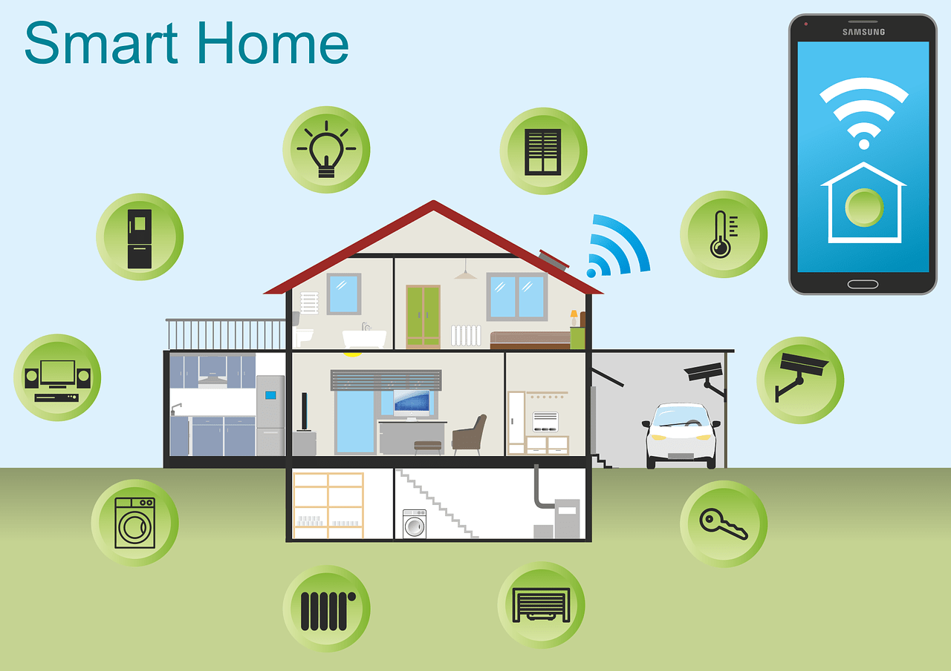
FROM GREENER IDEAL

Slide 13
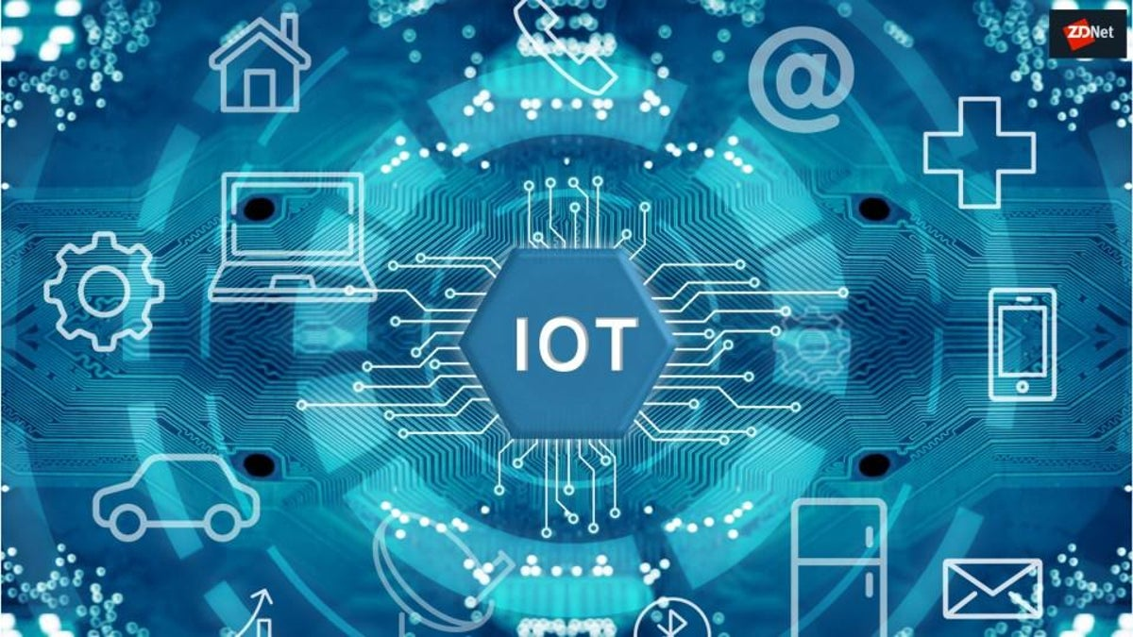
FROM ZDNet

Slide 14
What is the Internet of Things?
The Internet of Things, or IoT, refers to the billions of physical devices around the world that are now connected to the internet, all collecting and sharing data. Thanks to the arrival of super-cheap computer chips and the ubiquity of wireless networks, it's possible to turn anything, from something as small as a pill to something as big as an aeroplane, into a part of the IoT.
FROM ZDNet

Slide 15
What is an example of an Internet of Things device?
Pretty much any physical object can be transformed into an IoT device if it can be connected to the internet to be controlled or communicate information.
A lightbulb that can be switched on using a smartphone app is an IoT device, as is a motion sensor or a smart thermostat in your office or a connected streetlight. An IoT device could be as fluffy as a child's toy or as serious as a driverless truck. Some larger objects may themselves be filled with many smaller IoT components, such as a jet engine that's now filled with thousands of sensors collecting and transmitting data back to make sure it is operating efficiently. At an even bigger scale, smart cities projects are filling entire regions with sensors to help us understand and control the environment.
FROM ZDNet

Slide 16

FROM THE VERGE

Slide 17
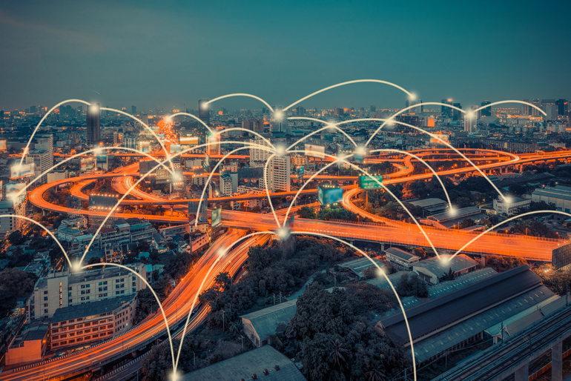
FROM ZDNet

Slide 18
How big is the Internet of Things?
Big and getting bigger -- there are already more connected things than people in the world.
Tech analyst company IDC predicts that in total there will be 41.6 billion connected IoT devices by 2025, or "things." It also suggests industrial and automotive equipment represent the largest opportunity of connected "things,", but it also sees strong adoption of smart home and wearable devices in the near term.
Another tech analyst, Gartner, predicts that the enterprise and automotive sectors will account for 5.8 billion devices this year, up almost a quarter on 2019. Utilities will be the highest user of IoT, thanks to the continuing rollout of smart meters. Security devices, in the form of intruder detection and web cameras will be the second biggest use of IoT devices. Building automation – like connected lighting – will be the fastest growing sector, followed by automotive (connected cars) and healthcare (monitoring of chronic conditions).
FROM ZDNet

Slide 19

FROM MEDIUM

Slide 20
PRESENT SITUATION OF IOT IN PAKISTAN

Slide 21


Slide 22
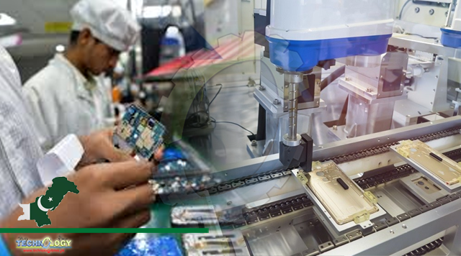
FROM Technology Times

Slide 23








Slide 24
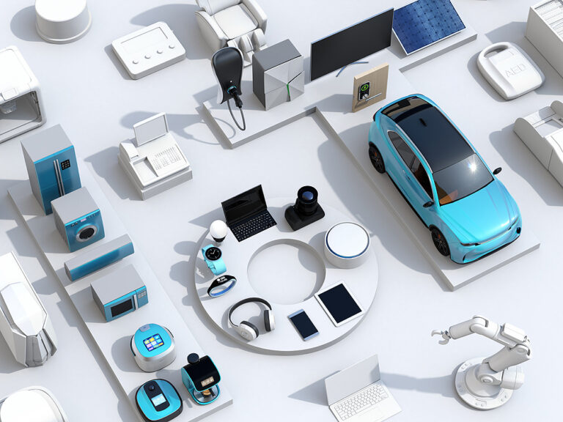
FROM Artificial Intelligence

Slide 25

FROM Pakistan & Gulf Economist

Slide 26
THANK YOU! THE END

